Slide 1
Fitness Tracker

Slide 2
Team Members
Ajeet Giri
Anubhav Patel
Dhiraj Guzzar
Kinjal Jain
Saket Saxena
Smriti Chaurasia
Vidisha Joshi

Slide 3
Introduction
The main objective of this project is to give some suggestions based on user’s BMI(Body Mass Index).
According to the BMI calculated the user is provided with a customized workout plan and meal for 30 days.
The user can evaluate his/her performance with the help of graphs which compares the expected and actual results of the workout.
There is also RSS feed which provides tips to stay fit and motivate the user for a better life.

Slide 4
Problem Statement
Personalized workout and fitness meal plan according to BMI
Matches the need of user according to height weight and gender
Interactive approach to track activities!!

Slide 5
Scope of the Project
This application will help users to be able to stay fit and updated with a healthy lifestyle
This application can be accessed easily and keeps you on track of your activities.
Application includes simple exercise with no equipments and provides you a with day meal.

Slide 6
Technology Stack Used
BackEnd
MySQL
Front End
HTML
CSS3
JQuery
Node 12.11.0
JavaScript
TypeScript
Bootstrap 4
Angular 8
MiddleWare
Java 8.x
Spring 5.1.9
Spring Boot 2.1.8
Eureka Discovery Client
Feign Client 1.2.6
Hibernate
JPA
Lombok

Slide 7
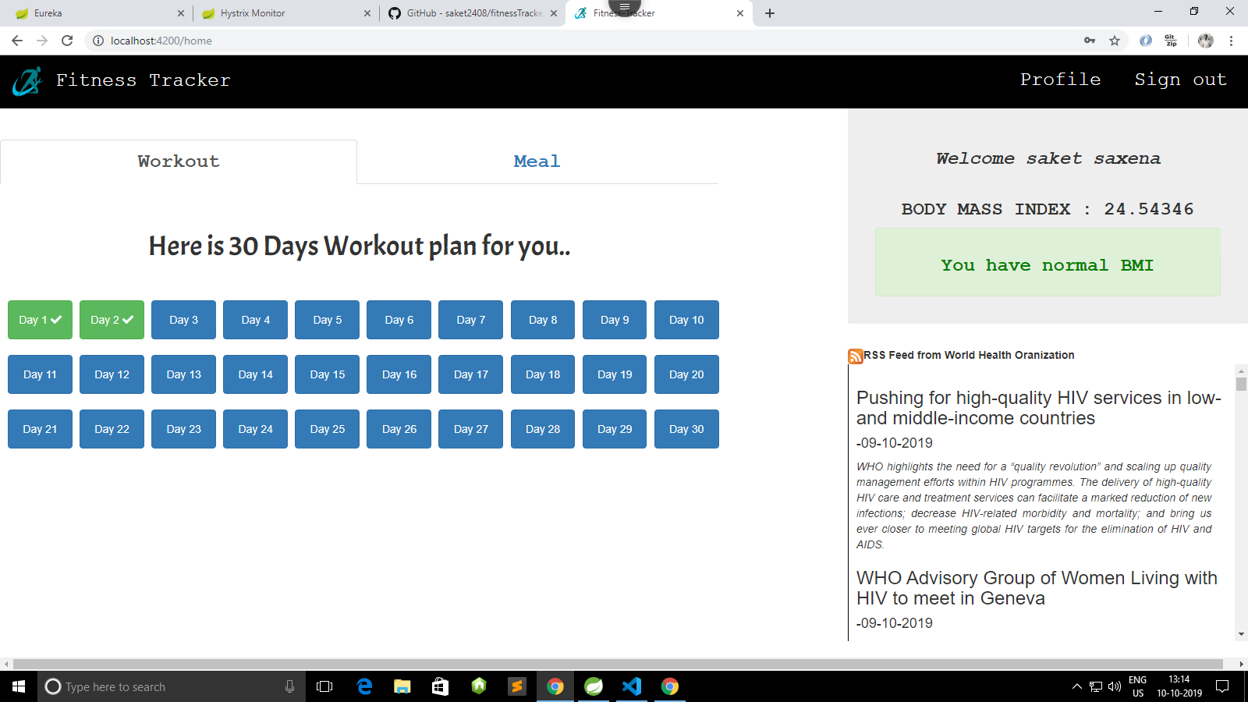
Demo
Let’s get into the Project to have a better understanding!

Slide 8
Database Architecture

Slide 9
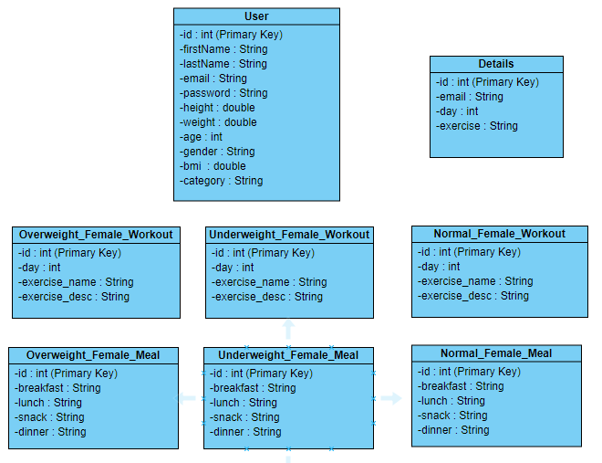
.

Slide 10
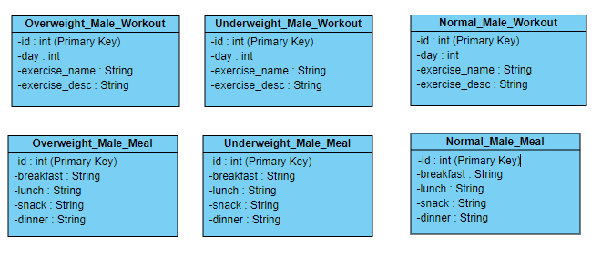
.

Slide 11
Microservice Architecture

Slide 12
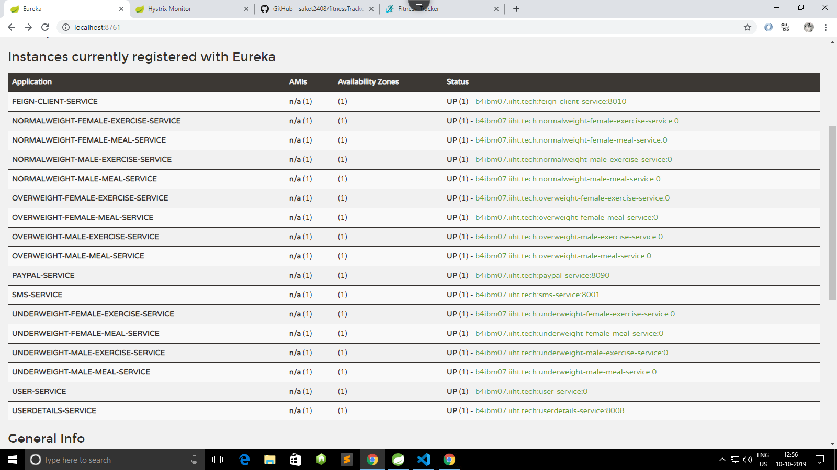
14 microservices are running in total

Slide 13
Angular Architecture

Slide 14
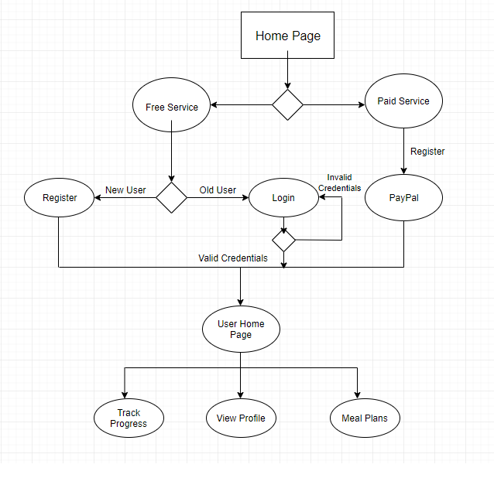
.

Slide 15
Deployment
Angular:
https://g2keqy6x0h.execute-api.eu-central-1.amazonaws.com/production (Amazon AWS)
https://fitnesstracker-4485b.firebaseapp.com/index (FireBase)
DataBase:
https://us-east-2.console.aws.amazon.com/rds/home?region=us-east-2#databases: (Amazon AWS)
Instance - fitnesstracker.cw7nexgyhixy.us-east-2.rds.amazonaws.com
Port – 3306
Spring:
ec2-3-14-66-15.us-east-2.compute.amazonaws.com (Amazon AWS)

Slide 16
Testing
Angular
Jasmine
Karma
Java
JUnit

Slide 17
Future Scope
Login using Spring Social
Valid Email verification
Payment Gateway
Track on the basis of date

Slide 18
Thank you!

